Slide 1
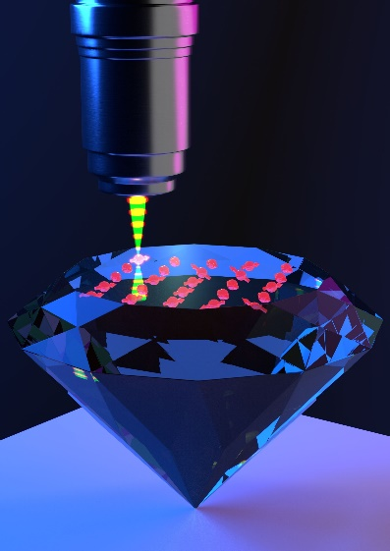
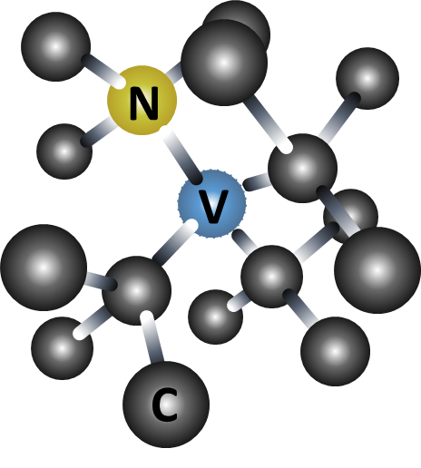
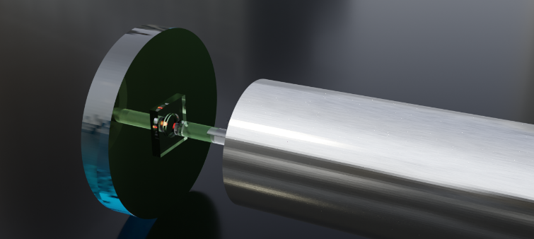

Nitrogen vacancy centers in diamond
Excited state
Ground state
Very good spin properties
Optically addressable spin
Solid state host: very robust and clean material
Enhance with optical cavities
Goal: build a large quantum network
https://qutech.nl/wp-content/uploads/2018/10/Quantum-Internet-Artist-Impression.jpg
Notes:
Storyline:

